Slide 1
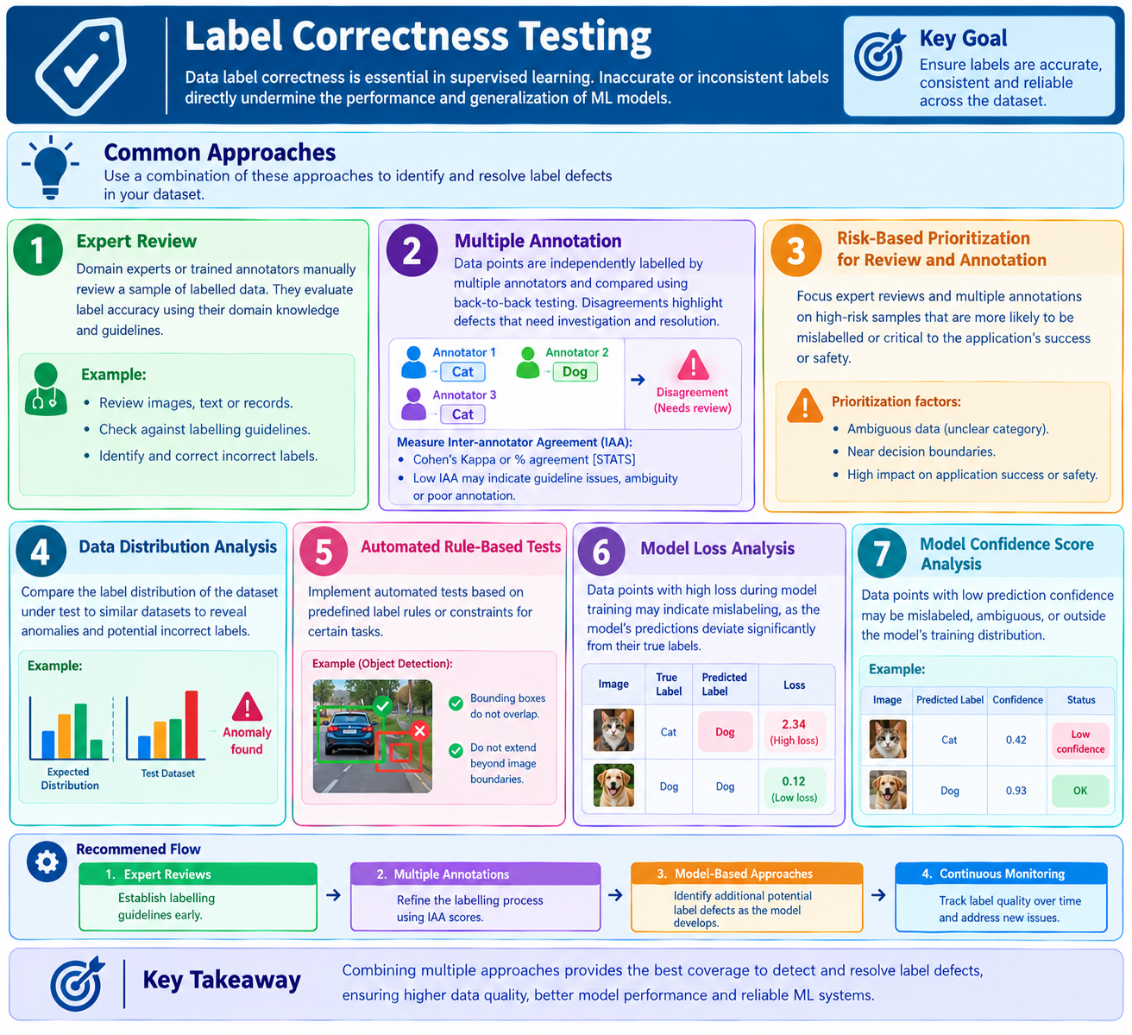
5.1.6 -Label Correctness Testing

Slide 2
THANK YOU!!!

